Slide 2
PSA System Operation 1
A produce
A produce
B regenerate
B purge
O2
Tank
B blowdown
A
B

Slide 3
PSA System Operation 2
B produce
B produce
A regenerate
A purge
O2
Tank
A blowdown
A
B

Slide 4
PSA System Operation 1
A produce
PSA System Operation 2
B produce
A produce
B regenerate
B purge
B produce
A regenerate
A purge
O2
Tank
O2
Tank
B blowdown
A blowdown
A
B
A
B

Slide 5
PSA System Operation 1
A produce
A produce
B regenerate
B purge
O2
Tank
B blowdown
A
B
PSA System Operation 2
B produce
B produce
A regenerate
A purge
O2
Tank
A blowdown
A
B

Slide 6
P
S
A
V
P
S
A

Slide 7
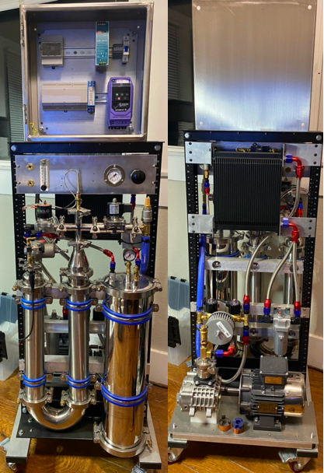
DT Host
PLC
VFD
Interface Panel
Cooler
Column
Coalescer
O2 Tank
PD Pump
Column Side
Air Side

Slide 8
Product out
Product Manifold
O2 Tank
Backpressure Regulator
Adsorbent Column
Reversing Pump
Purge Valve
Drier/Condenser
Slice 1 Producing
Slice 2 Regenerating
Slice 3 Standby

